Slide 1





THEORY
Training Program 01
Advanced NLP & Large Language Models (LLMs)

Slide 2
THEORY
Training Program 01
M01: Text Preprocessing
M02: Word and Sentence Embeddings
M03: Transformer Architectures
M04: Entity-Centric NLP
M05: Applied NLP Tasks
M06: Multimodal NLP
M07: LLM Fundamentals
M08: Prompt Engineering
M09: Fine-Tuning & PEFT
M10: RAG & Real-World Projects

Slide 3
MODULE M01
TEXT PREPROCESSING
CHAPTER M04
Prompt Engineering

Slide 4
THEORY
Training Program 01
7.1 Introduction to Large Language Models (LLMs)
7.2 LLM Scaling Laws: The Economics of AI
7.3 Foundation Model Pre-training Objectives
7.4 Adaptation: Fine-Tuning and Alignment
7.5 Understanding and Extending Context Length
7.6 Summary and Key Takeaways

Slide 5
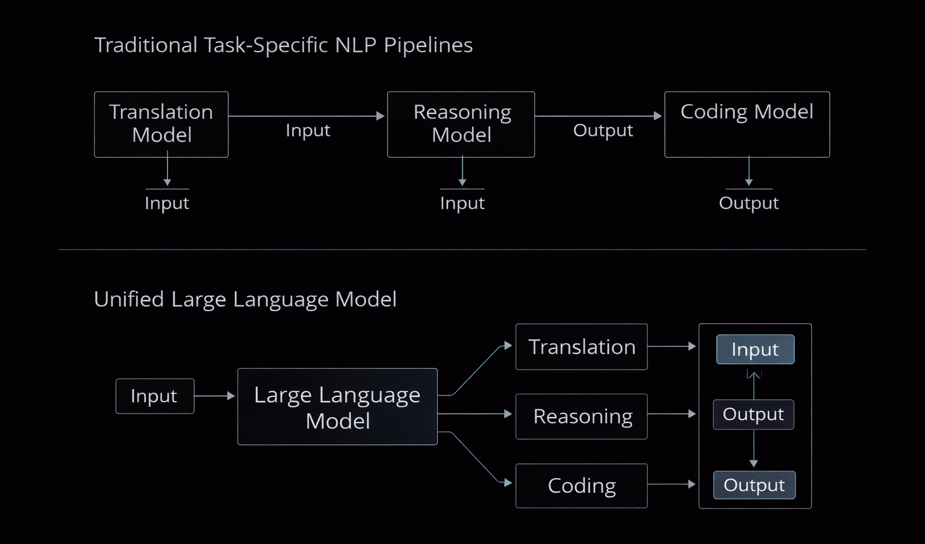
M07
Chapter 7.1: Introduction to Large Language Models (LLMs)
What Is a Large Language Model?
Large Language Models (LLMs) represent a shift from task-specific NLP systems to general-purpose cognitive engines. Their intelligence emerges from scale, not from handcrafted rules.
LLMs are general-purpose models, not single-task systems.
Capabilities emerge from scale + data, not explicit programming.
Intelligence is an emergent property, not a designed feature.
One model can perform reasoning, coding, translation, and analysis.

Slide 6
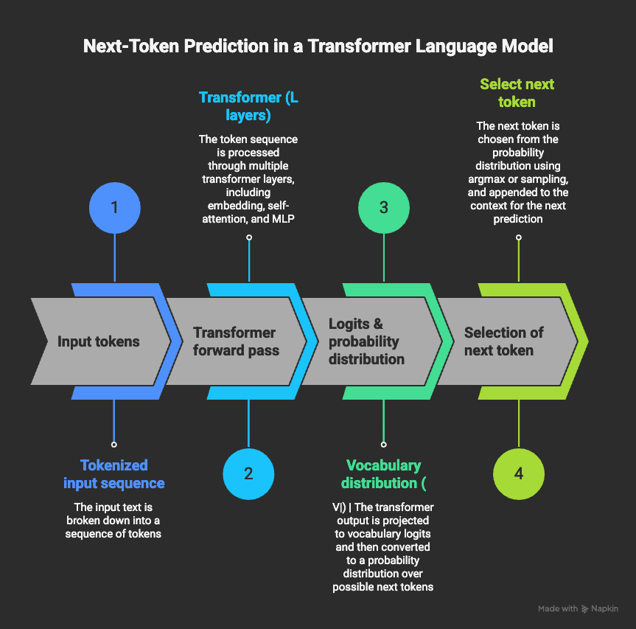
M07
Chapter 7.1: Introduction to Large Language Models (LLMs)
The Core Mechanism: Next-Token Prediction
At its foundation, an LLM is a probabilistic system trained to predict the next token in a sequence. This simple objective enables complex reasoning when applied at massive scale.
Core objective: predict the next token given prior context
Model learns probability distributions over a large vocabulary
Grammar, facts, and logic emerge from statistical learning
No symbolic rules, only probabilistic inference

Slide 7
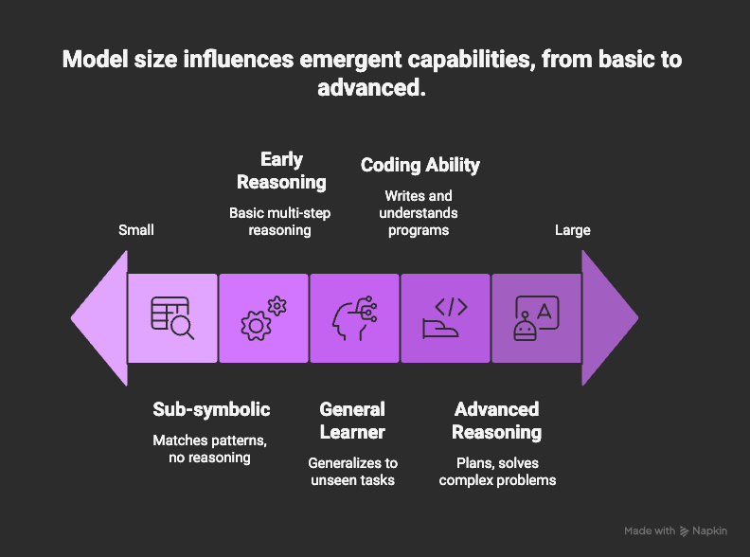
M07
Chapter 7.1: Introduction to Large Language Models (LLMs)
What Makes a Model ‘Large’?
LLMs are defined not just by architecture, but by quantitative scale. Parameters, data volume, and compute together determine whether advanced capabilities emerge.
Parameter counts range from billions to trillions.
Training data includes most public human text and code.
Scale enables emergent abilities (reasoning, zero-shot learning).
Small models cannot reliably display these behaviors.

Slide 8
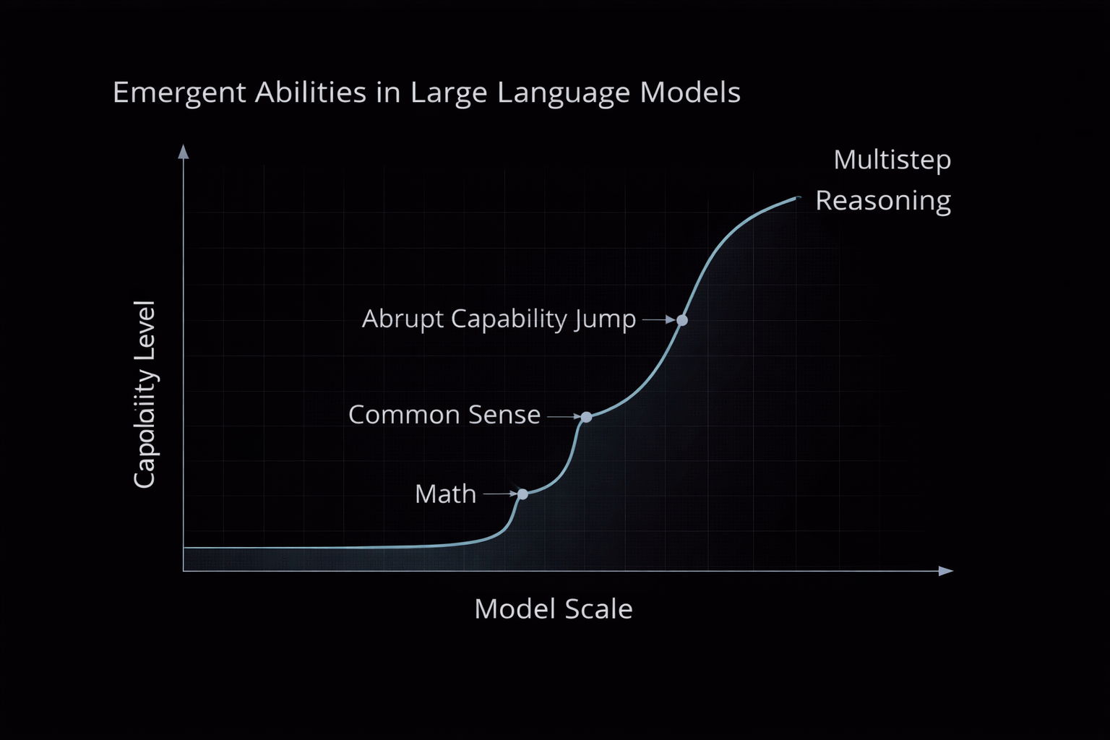
M07
Chapter 7.1: Introduction to Large Language Models (LLMs)
Emergent Abilities and
Threshold Effects
Emergent abilities are non-linear effects of scale
Examples: arithmetic reasoning, code synthesis, abstraction
Abilities are unpredictable at small scales
Scaling acts as a capability unlock mechanism

Slide 9
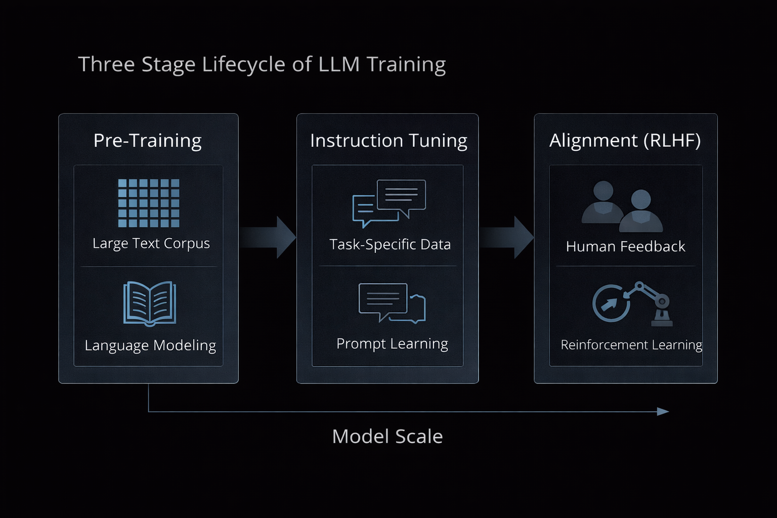
M07
Chapter 7.1: Introduction to Large Language Models (LLMs)
The Lifecycle of an LLM
LLMs are not deployed directly after pre-training. They undergo a structured lifecycle that transforms raw statistical models into usable, aligned assistants.
Pre-training: learn language and world patterns
Instruction tuning: learn how to respond to humans
Alignment (RLHF): optimize behavior and safety
Each phase adds control and usefulness

Slide 10
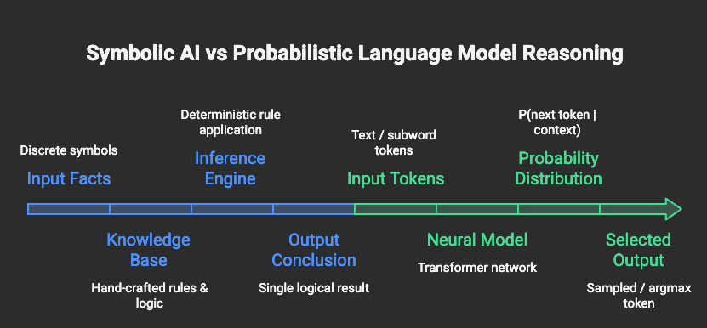
M07
Chapter 7.1: Introduction to Large Language Models (LLMs)
Why This Matters Technically
Understanding what an LLM is, and what it is not, is critical for using it correctly. LLMs do not reason symbolically; they approximate reasoning through probability.
LLMs are probabilistic, not deterministic systems.
They simulate reasoning via learned patterns.
Strengths and limits both arise from this design.
Proper usage requires understanding this foundation.

Slide 11
THEORY
Training Program 01
7.1 Introduction to Large Language Models (LLMs)
7.2 LLM Scaling Laws: The Economics of AI
7.3 Foundation Model Pre-training Objectives
7.4 Adaptation: Fine-Tuning and Alignment
7.5 Understanding and Extending Context Length
7.6 Summary and Key Takeaways

Slide 12
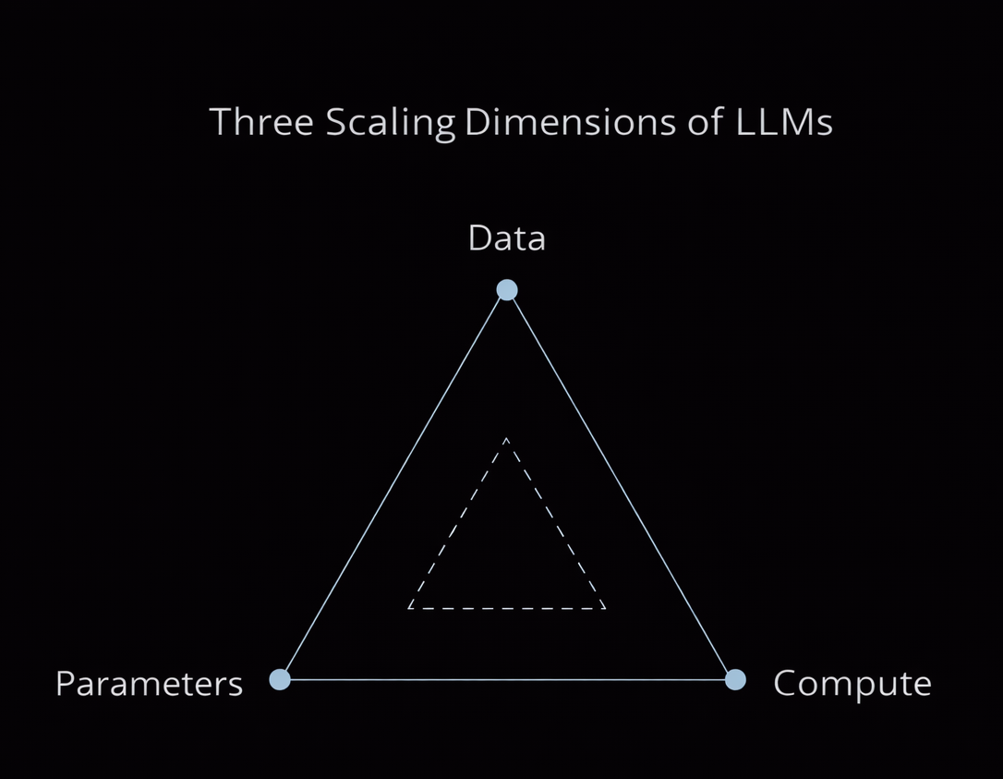
M07
Chapter 7.2 LLM Scaling Laws: The Economics of AI
The Three Scaling Dimensions
LLM performance follows power-law scaling, not randomness.
Three core variables: Parameters (N), Data (D), Compute ©.
Increasing only one factor leads to inefficient training.
Balanced scaling produces consistent loss reduction.

Slide 13
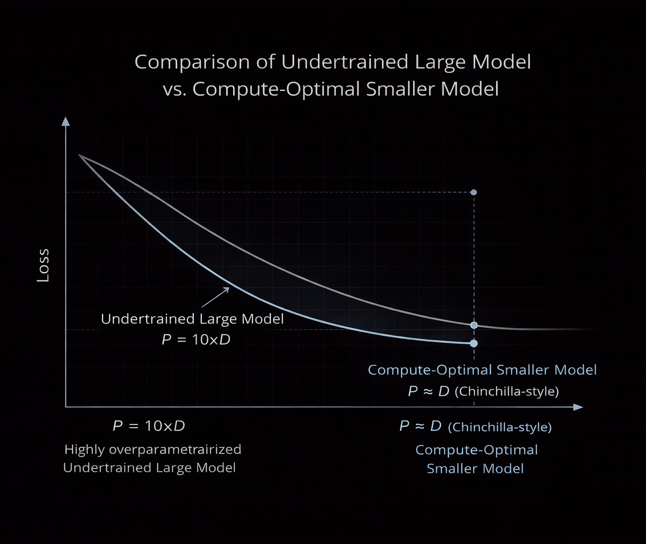
M07
Chapter 7.2 LLM Scaling Laws: The Economics of AI
Chinchilla and Compute-Optimal Training
Chinchilla demonstrated that many early LLMs were inefficiently trained. Optimal performance requires matching model size with sufficient training data.
Most early models were undertrained
Chinchilla ratio: ~20 tokens per parameter
Smaller models + more data can outperform larger ones
Shift toward data-efficient foundation models

Slide 14
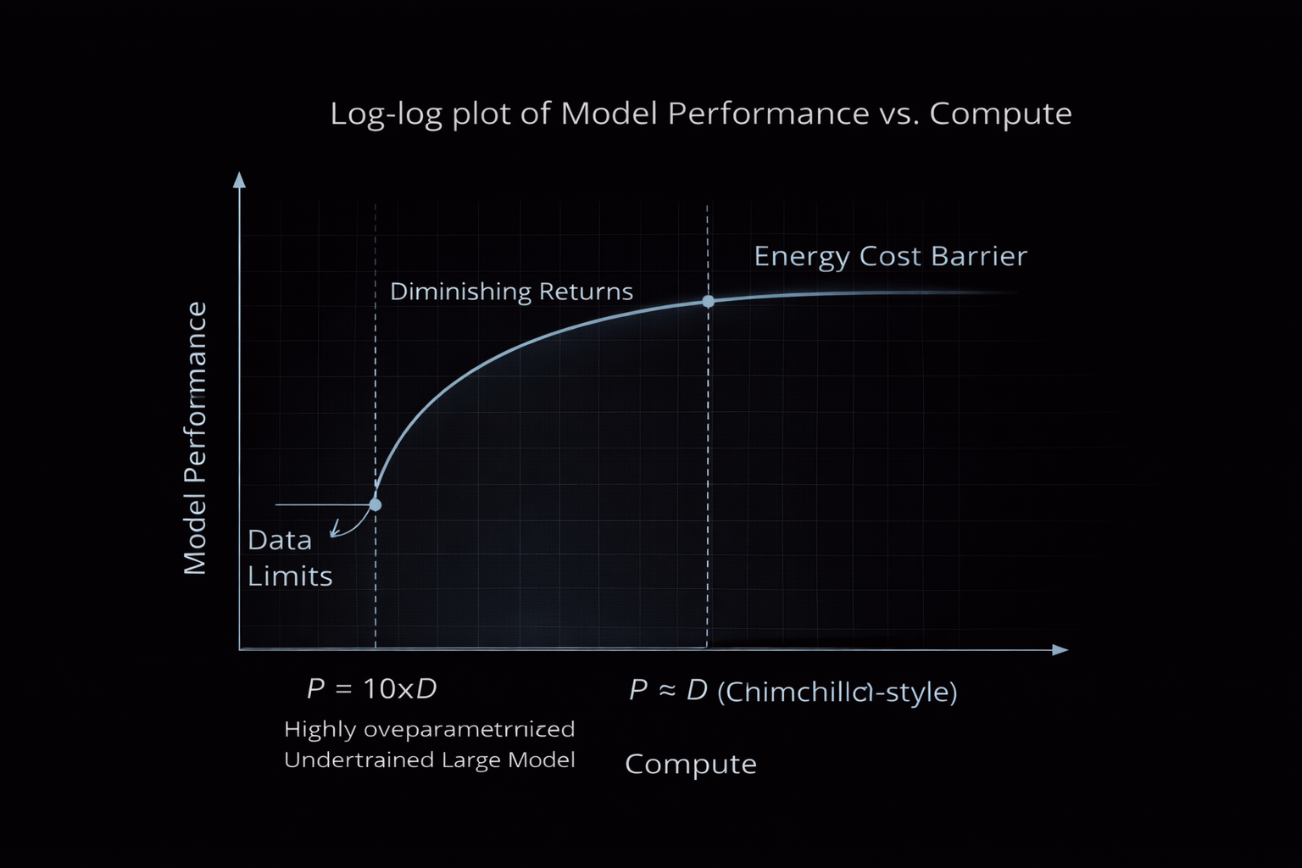
M07
Chapter 7.2 LLM Scaling Laws: The Economics of AI
Economic Limits and Diminishing Returns
While scaling improves intelligence, it faces physical and economic limits. Beyond certain sizes, gains become increasingly expensive and marginal.
Scaling shows diminishing returns at trillion-parameter scale.
Constraints: data exhaustion, energy cost, hardware limits.
Compute budgets define feasible model size.
Future gains depend more on data quality and efficiency.

Slide 15
THEORY
Training Program 01
7.1 Introduction to Large Language Models (LLMs)
7.2 LLM Scaling Laws: The Economics of AI
7.3 Foundation Model Pre-training Objectives
7.4 Adaptation: Fine-Tuning and Alignment
7.5 Understanding and Extending Context Length
7.6 Summary and Key Takeaways

Slide 16
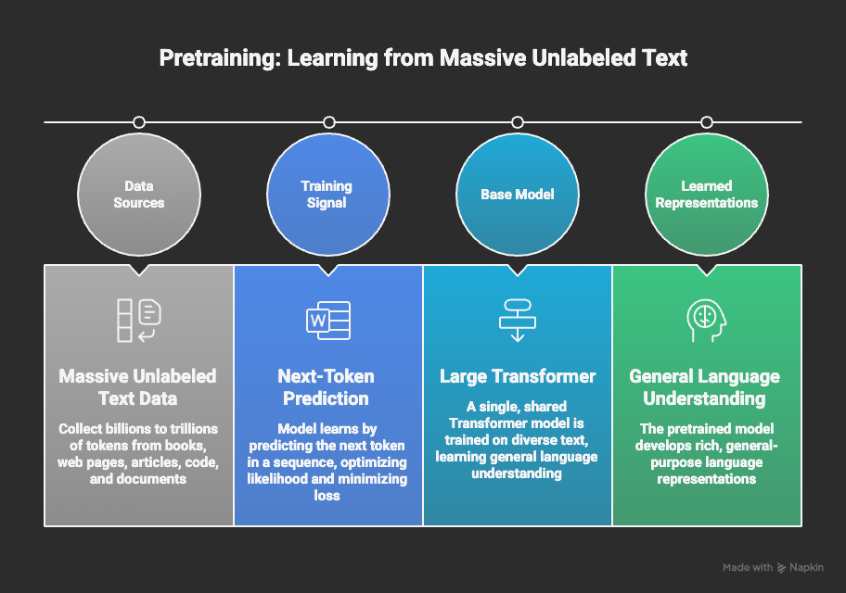
M07
Chapter 7.3 Foundation Model Pre-training Objectives
Purpose of Pre-training
Pre-training is the phase where an LLM acquires general intelligence from raw data. The model learns language structure and world knowledge through self-supervised learning at scale.
Pre-training uses self-supervised learning.
No human labels: supervision comes from next-token prediction.
Objective: build a statistical model of language and facts.
Forms the base model used for all downstream tasks.

Slide 17
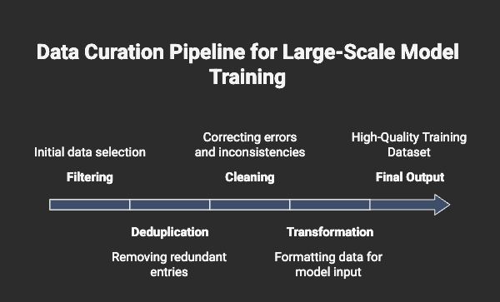
M07
Chapter 7.3 Foundation Model Pre-training Objectives
Data Collection and Filtering
Sources include Common Crawl, books, code, academic text.
Heavy deduplication to avoid memorization.
Removal of spam, boilerplate HTML, low-quality text.
Data diversity enables multi-domain reasoning.

Slide 18
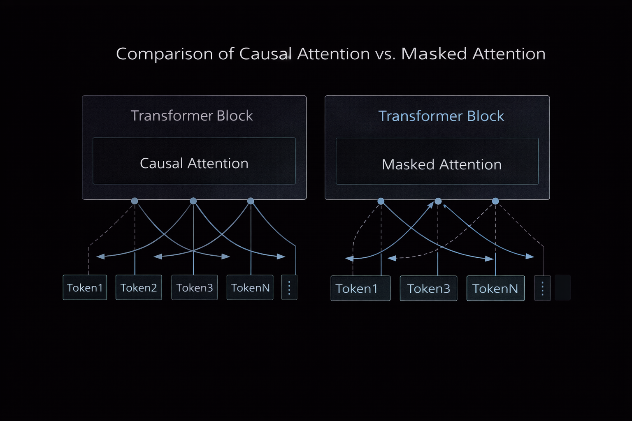
M07
Chapter 7.3 Foundation Model Pre-training Objectives
Causal vs Masked
Language Modeling
Different pre-training objectives lead to different model behaviors. Generative and understanding-focused models are trained using distinct learning strategies.
Causal Language Modeling (CLM) → GPT-style generation.
Predicts the next token left-to-right.
Masked Language Modeling (MLM) → BERT-style understanding.
Bidirectional context but weaker for generation.

Slide 19
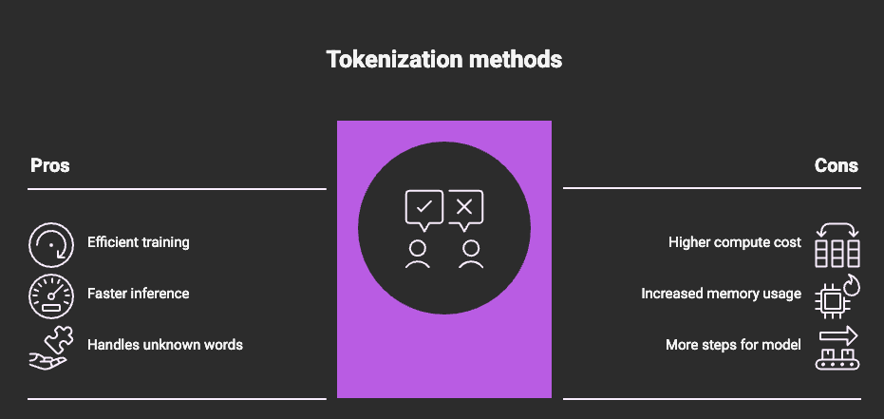
M07
Chapter 7.3 Foundation Model Pre-training Objectives
Tokenization as a Bottleneck
The tokenizer defines how efficiently the model perceives text. Poor tokenization wastes context and limits reasoning capacity.
Tokenizer determines information density.
Modern models use BPE / SentencePiece.
Large vocabularies (50k–128k tokens) reduce fragmentation.
Token efficiency directly impacts context window usage.

Slide 20
THEORY
Training Program 01
7.1 Introduction to Large Language Models (LLMs)
7.2 LLM Scaling Laws: The Economics of AI
7.3 Foundation Model Pre-training Objectives
7.4 Adaptation: Fine-Tuning and Alignment
7.5 Understanding and Extending Context Length
7.6 Summary and Key Takeaways

Slide 21
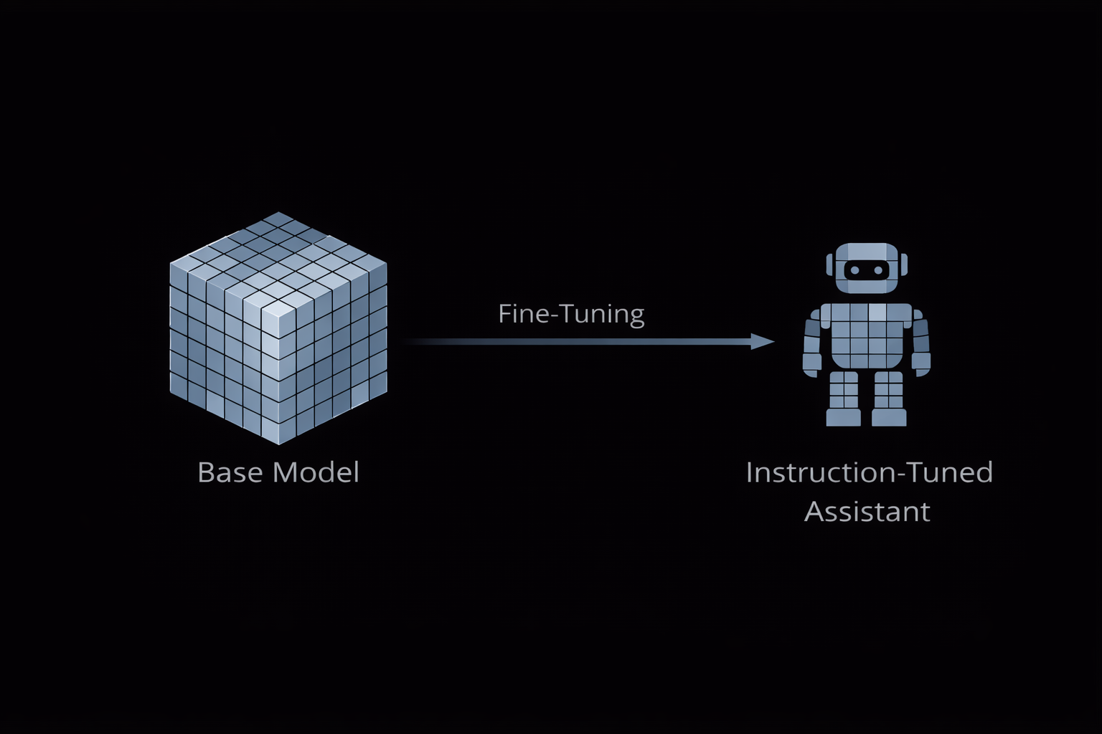
M07
Chapter 7.4 Adaptation: Fine-Tuning and Alignment
From Pre-training to Fine-Tuning
Pre-training gives models knowledge, but not behavior. Fine-tuning is the phase where a base model is transformed into a useful, task-oriented assistant.
Pre-trained models are generic text completers.
Fine-tuning teaches how to respond, not what language is.
Uses curated instruction–response pairs.
Converts raw capability into practical utility.
.

Slide 22
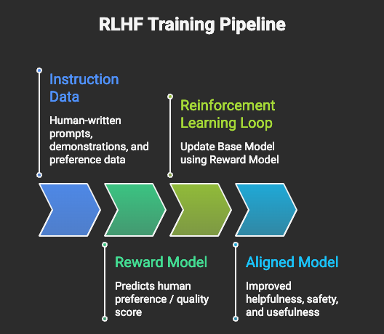
M07
Chapter 7.4 Adaptation: Fine-Tuning and Alignment
Instruction Tuning and RLHF
Instruction tuning and human feedback align model outputs with human expectations. This step shapes tone, usefulness, and safety.
SFT (Supervised Fine-Tuning) teaches response format.
RLHF aligns outputs with human preferences.
Humans rank answers → Reward Model is trained.
Policy optimized to be helpful, honest, and harmless.
.

Slide 23
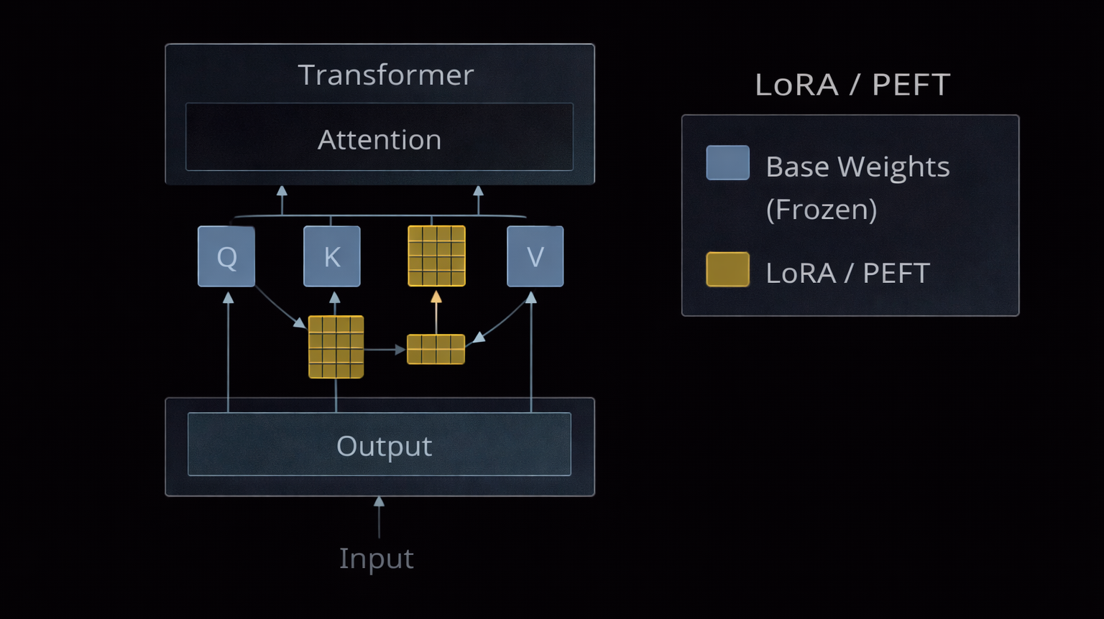
M07
Chapter 7.4 Adaptation: Fine-Tuning and Alignment
Parameter-Efficient Fine-Tuning (PEFT)
As models scale, full fine-tuning becomes impractical. PEFT enables specialization with minimal compute and memory.
Base model weights remain frozen.
Only a small % of parameters are trained.
LoRA is the dominant PEFT technique.
Enables fast, low-cost domain adaptation.
.

Slide 24
THEORY
Training Program 01
7.1 Introduction to Large Language Models (LLMs)
7.2 LLM Scaling Laws: The Economics of AI
7.3 Foundation Model Pre-training Objectives
7.4 Adaptation: Fine-Tuning and Alignment
7.5 Understanding and Extending Context Length
7.6 Summary and Key Takeaways

Slide 25
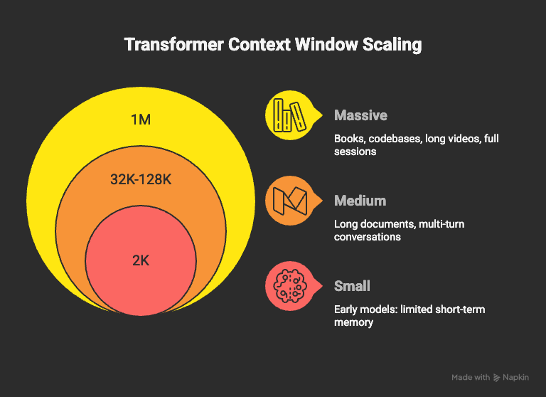
M07
Chapter 7.5 Understanding and Extending Context Length.
Context Window and Its Limits
The context window defines how much information an LLM can “remember” at once. Extending it enables long-document reasoning but introduces severe computational constraints.
Context window = maximum tokens per inference
Early models: 512–2,048 tokens
Modern models: 128k → 1M+ tokens
Enables book-level, codebase, and video analysis
.

Slide 26
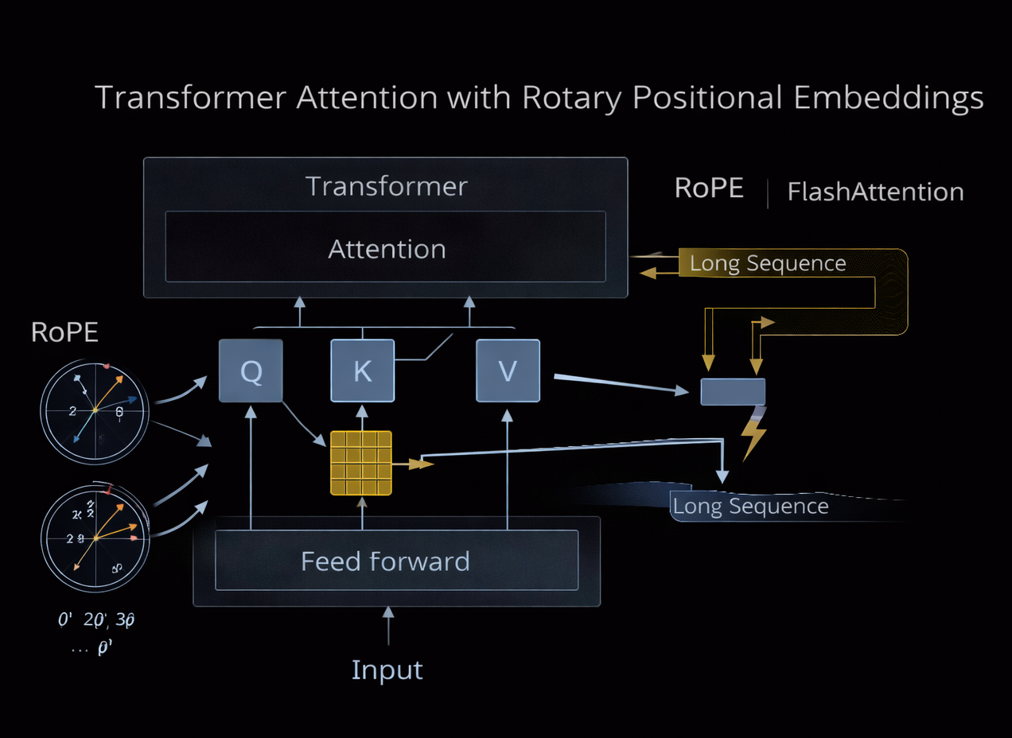
M07
Chapter 7.5 Understanding and Extending Context Length.
Context Window and Its Limits
Modern architectures bypass attention limits through algorithmic and positional innovations that preserve reasoning across long sequences.
FlashAttention reduces memory overhead
RoPE enables context extrapolation
ALiBi biases attention by distance
Solves ‘Lost in the Middle’ problem
.

Slide 27
THEORY
Training Program 01
7.1 Introduction to Large Language Models (LLMs)
7.2 LLM Scaling Laws: The Economics of AI
7.3 Foundation Model Pre-training Objectives
7.4 Adaptation: Fine-Tuning and Alignment
7.5 Understanding and Extending Context Length
7.6 Summary and Key Takeaways

Slide 28
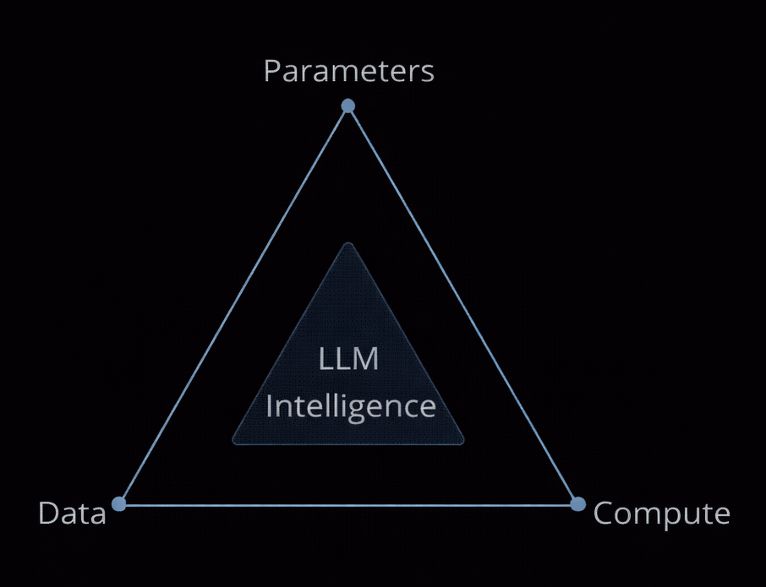
M07
Chapter 7.6 Summary and Key Takeaways
Core Takeaways from LLM Fundamentals
Large Language Models follow predictable technical laws rather than magic. Their capabilities emerge from the structured interaction between scale, data quality, and optimization.
Intelligence emerges from scale, not rules.
Performance depends on parameters, data, and compute.
Pre-training builds knowledge, fine-tuning builds behavior.
Context length defines reasoning depth.
.

Slide 29
M07
Chapter 7.6 Summary and Key Takeaways
Practical Trade-offs and Future Direction
Rather than being opaque or unpredictable systems, LLMs follow measurable laws driven by scale, data quality, and optimization strategies. Understanding these constraints is essential for designing reliable and economically viable AI systems.
Trade-off between performance, cost, and latency.
Data quality sets the upper intelligence limit.
Scaling alone shows diminishing returns.
Future focus: efficiency, alignment, and control.
.

Slide 30
M04
Academic & Technical References
Vaswani et al. (2017) — Attention Is All You Need.
Brown et al. (2020) — Language Models are Few-Shot Learners.
Kaplan et al. (2020) — Scaling Laws for Neural Language Models.
Hoffmann et al. (2022) — Training Compute-Optimal Large Language Models (Chinchilla).
Wei et al. (2022) — Emergent Abilities of Large Language Models.
Radford & Narasimhan (2018) — Improving Language Understanding by Generative Pre-Training.
Touvron et al. (2023) — LLaMA: Open and Efficient Foundation Language Models.

Slide 31
M04
Academic & Technical References
Penedo et al. (2023) — The RefinedWeb Dataset.
Ouyang et al. (2022) — Training Language Models to Follow Instructions with Human Feedback.
Rafailov et al. (2023) — Direct Preference Optimization (DPO).
Su et al. (2021) — RoFormer: Rotary Position Embedding.
Dao et al. (2022) — FlashAttention.

